Slide 1
CODING

Slide 2
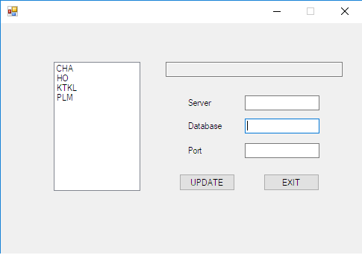
INTERFACE

Slide 3


DATABASE TABLES

Slide 4
LOGIC
Connect to database.
List branches from branchmaster.
Select dbcode of clicked branch from databasemapping.
If no dbcode exists, on clicking update insert data to databasemaster and databasemapping.
Else, update data in databasemaster.

Slide 5
Connection String
NAME SPACES
using System.Data;
using System.Configuration;
using MySql.Data.MySqlClient;
"Data Source="";Initial Catalog="";User ID="";Password="";
MySqlConnection(connectionString);
Open connection.
Close connection.

Slide 6
DATA ADAPTERS AND DATASET
DataAdapter is used to retrieve data from a data source and populate tables within a DataSet.
The DataAdapter also resolves changes made to the DataSet back to the data source.
The Fill method uses the DataReader object implicitly to return the column names and types used to create the tables in the DataSet, as well as the data to populate the rows of the tables in the DataSet.
Dataset represents a collection of data retrieved from the Data Source and saving data to the Data Source.

